Slide 1
Roy Lisker’s Book of Drawings 2013
rlisker@yahoo.com
www.fermentmagazine.org

Slide 2
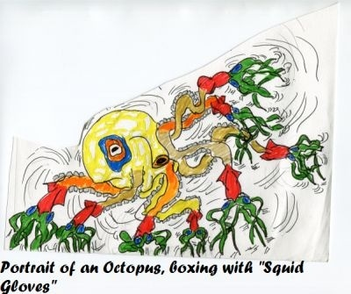

Slide 3
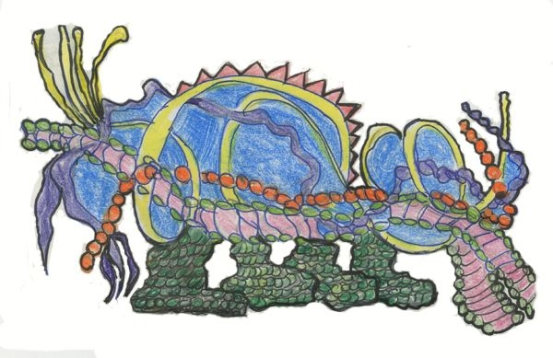
Fafner’s Cousin

Slide 4
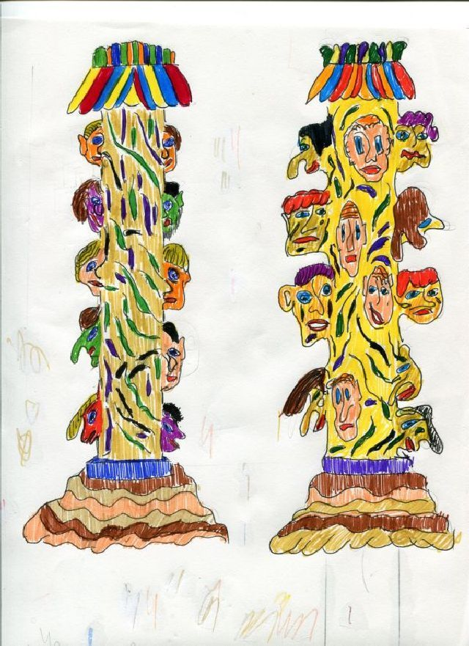
Totem Columns

Slide 5
Barbarian Totem

Slide 6
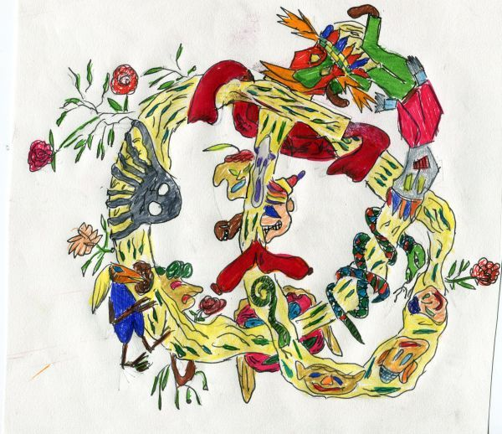
Trefoil Totem

Slide 7
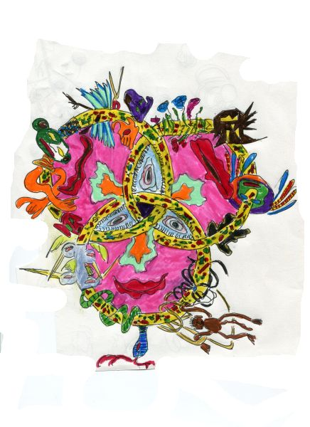
Lords of the Ring

Slide 8
Animal Rights Totem

Slide 9
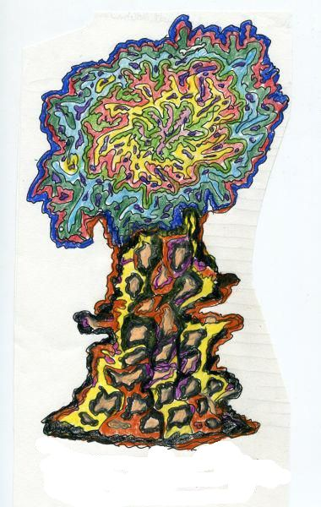
There is a Tree in Paradise,
The Pilgrims call the Tree of Life

Slide 10
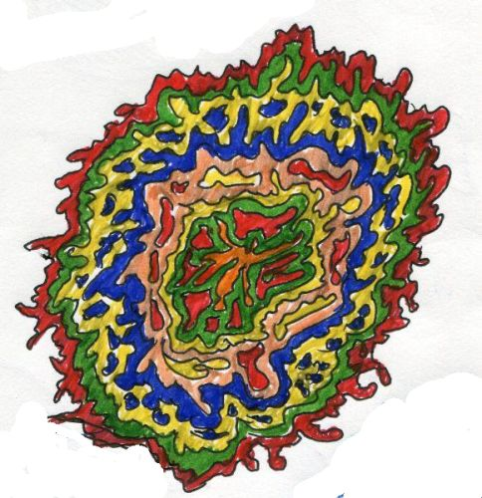
Cat-Scan of the Mind of a Holy Sadhu

Slide 11
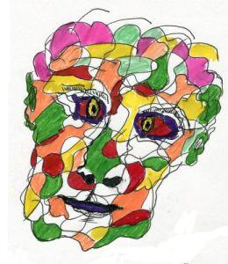
Dionysus

Slide 12
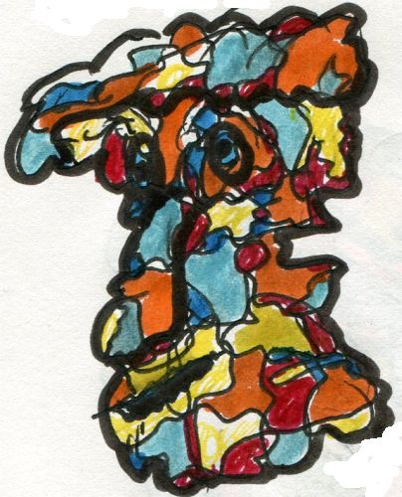
The Traveller from an Antique Land

Slide 13
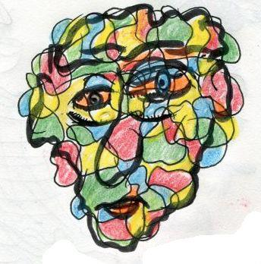
The Guru of Structural Linguistics

Slide 14
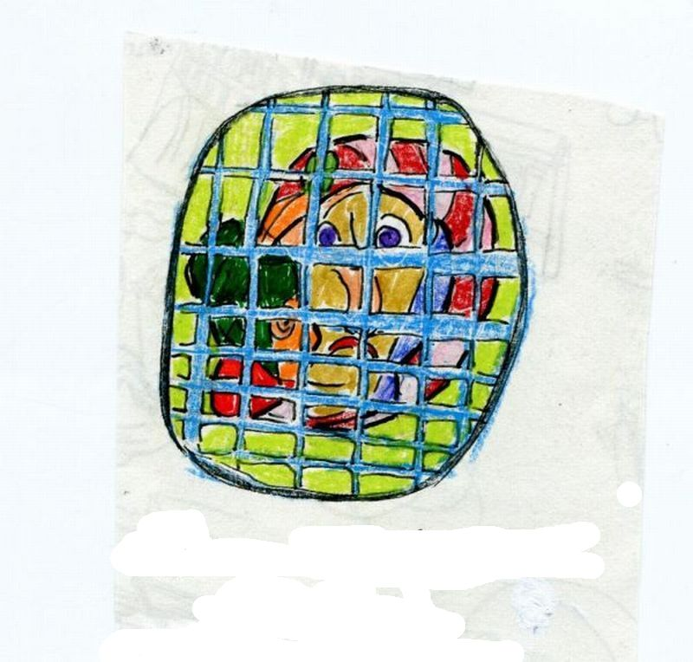
Madonna and Child, With Snake
In Prison

Slide 15
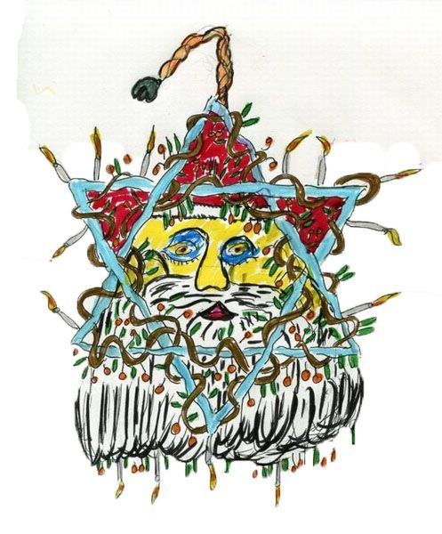
The Mitzva Santa Claus

Slide 16
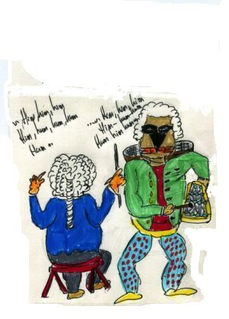
Rehearsing the first performance of The Magic Flute.
Mozart coaches Papageno, (sung by Schikaneder)
in humming

Slide 17
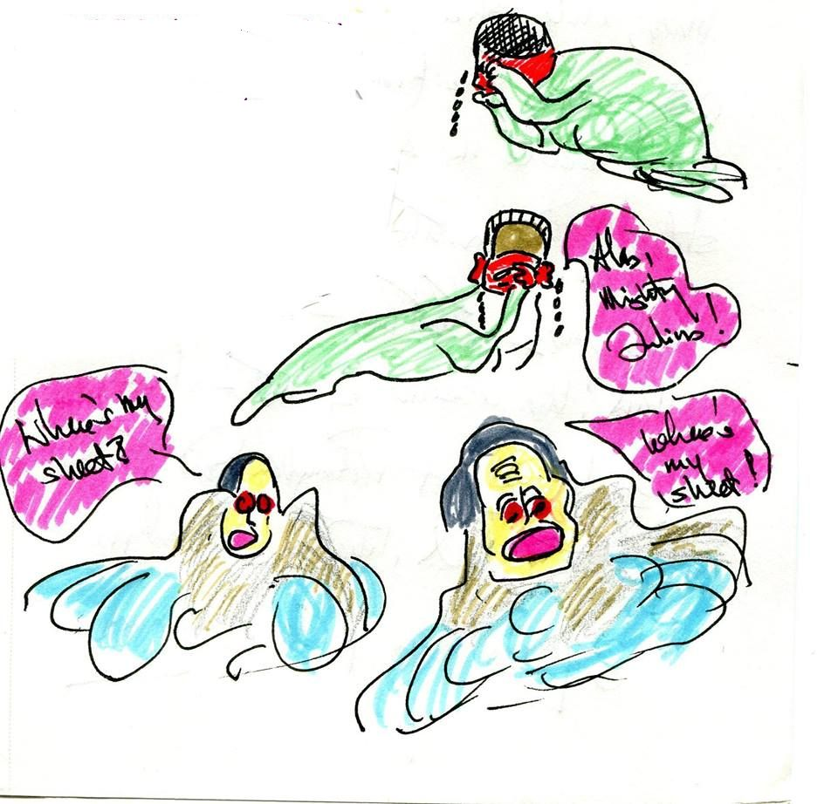
When ,in the high and palmy state of Rome
A moment ere the mighty Julius fell
The graves stood tenantless
And the UN*sheeted dead
Did squeak and gibber in the streets!
___________________
(*modification)

Slide 18
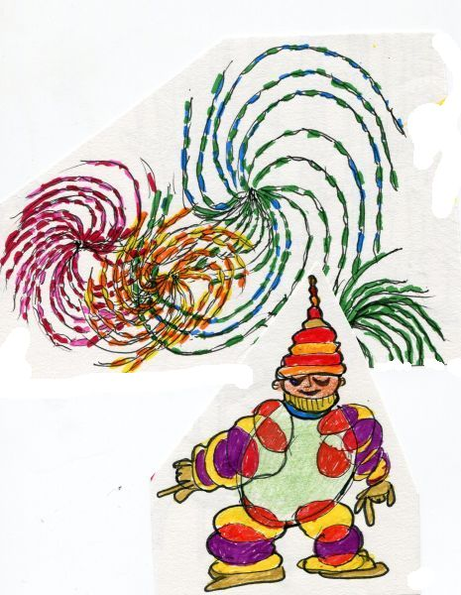
The Creation of the Universe
by Boson the Clone

Slide 19
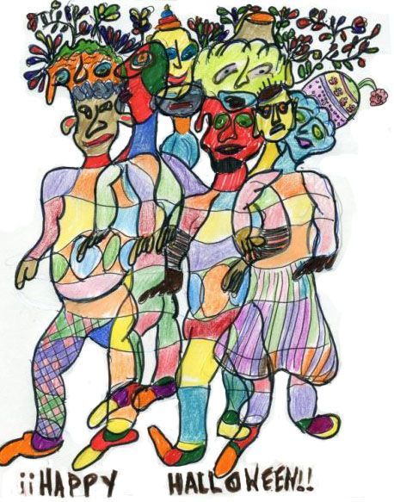

Slide 20
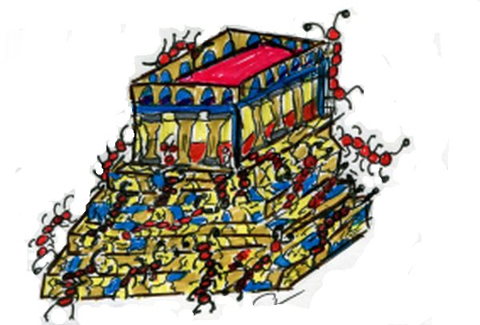
Assault On Western Civilization

Slide 21
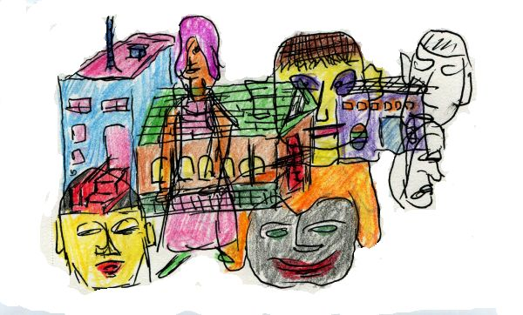
Wraithes

Slide 22
